Slide 1
my life before and after meeting CLEAN ARCHITECTURE

Slide 2

Roc Boronat a pragmatic clean architecture lover

Slide 3
my life before
…was young, need the money

Slide 4
logic everywhere
a smart .jsp with a smart .js calling a smarty java that is calling a stored procedure

Slide 5
high coupling
«pass the Context, it’s funny!»

Slide 6
low cohesion
classes that recieve an httprequest, check the database and fill the cache before answering

Slide 7
patches everywhere
android «magic» fixes and my own business rules are totally mixed

Slide 8
test? what test?
working with architectures driven by people who doesn’t test
run the app to test eeeeeeeeeeeeeeverything

Slide 9
my life after
thank you InfoJobs!

Slide 10
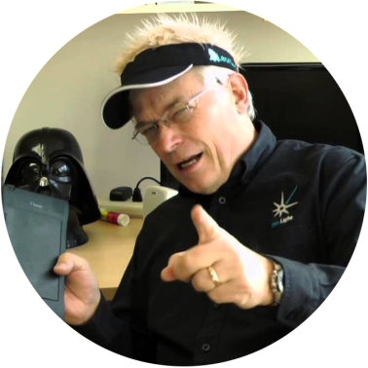
Robert C. Martin
SOLID
Clean Architecture
Software Craftmanship
Agile Manifesto

Slide 11
SOLID?

Slide 12
SOLID
single responsability principle
do one thing well

Slide 13
SOLID
open / closed principle
open for extension, closed for modification

Slide 14
SOLID
liskov substitution principle
sorry! cannot write a good short definition!

Slide 15
SOLID
interface segregation principle
lots of small interfaces instead of a big one

Slide 16
SOLID
dependency inversion principle
depend upon abstractions, not upon concretions

Slide 17
CLEAN ARCHITECTURE?
…let the party start!

Slide 18
what?
independent of frameworks
frameworks are tools, let’s focus on the business rules.

Slide 19
what?
testable
business rules can be tested without UI, databases, web servers, a phone, a banana

Slide 20
what?
independent of ui
the UI can change ‘cause the business rules remain the same

Slide 21
what?
independent of database
business rules are not bound to the database, so you can change it

Slide 22
what?
independent of external *
business rules don’t know anything about the outside world

Slide 23
show me something please

Slide 24
enterprise wide business rules
could be used by different applications in the enterprise
these are the less likely to change when some external changes
entities

Slide 25
application specific business rules
they use entities to achieve a goal
it will change if the operation of the application changes
ui? databases? It’s totally isolated
entities
use cases

Slide 26
translates data from use case and entities to an external agency
converts requests from the outer layers to the inner ones
entities
use cases
adapters

Slide 27
android screens, web, database, a distributed cache… are details
keeping them outside where they can do little harm
entities
use cases
adapters
frameworks

Slide 28
The Dependency Rule
entities are alone
use cases know entities
adapters know use cases
frameworks know adapters
entities
use cases
adapters
frameworks

Slide 29
Only four circles?
nope, do what you need
but
Respect The Dependency Rule

Slide 30
what about the code?
tired of abstractness?

Slide 31

Jorge Barroso InfoJobs’ architecture father Karumi Android Expert

Slide 32
api
android view
controller
job
datasource
local storage

Slide 33
api
Curriculums ListApi
android view
controller
job
datasource
CVActivity CVFragment
CVController
ObtainCVJob
CurriculumsDataSource
local storage
List <Curriculum>

Slide 34
how the data travels?
api
android view
controller
job
datasource
local storage

Slide 35
how the data travels?
api
android view
controller
job
datasource
local storage
ViewModel
DomainModel
ApiModel

Slide 36
how the data travels?
api
android view
controller
job
datasource
local storage
"23 d’abril"
Date
"1986-04-23T01:42:01Z"
ViewModel
DomainModel
ApiModel

Slide 37
how to manage async?
api
android view
controller
job
datasource
local storage

Slide 38
how to manage async?
android-priority-jobqueue https://github.com/path/android-priority-jobqueue
api
android view
controller
job
datasource
local storage

Slide 39
how to manage async?
android-priority-jobqueue https://github.com/path/android-priority-jobqueue
api
android view
controller
job
datasource
local storage
callback
implementation
callback interface

Slide 40
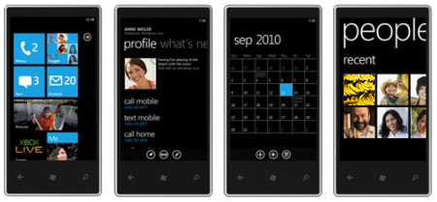
it’s question time!

Slide 41
references
“Clean Architecture and Design” by Uncle Bob
https://www.youtube.com/watch?v=Nsjsiz2A9mg
“The Clean Architecture” by Uncle Bob
https://blog.8thlight.com/uncle-bob/2012/08/13/the-clean-architecture.html
“Forgetting Android” by Jorge Barroso
https://www.youtube.com/watch?v=ROdIvrLL1ao
http://www.slideshare.net/flipper83/forgetting-android-v2
“Architecting Android… the clean way?” by Fernando Cejas
http://fernandocejas.com/2014/09/03/architecting-android-the-clean-way
“What is all this Clean Architecture jibber-jabber about?” by Pablo Guardiola
http://pguardiola.com/blog/clean-architecture-part-1/
http://pguardiola.com/blog/clean-architecture-part-2/
“Introducción a Clean Architecture” by Tempos21
http://www.tempos21.com/web/blog/introduccion-clean-architecture

